Slide 1
Twitter API
John, Yuan, Ludan, Ryan

Slide 2
Layout
Collect data from 10 Twitter accounts using Twitter API
Inserted data into MongoDB
Pulled the data from MongoDB into a JSON file when the page loads using Flask
Uses JavaScript to read the JSON file and create visualizations

Slide 3
Topic of Interest
How do interactions with social media accounts differ across industries?
How strong is the correlation between retweets and likes, quotes and likes, and replies and likes?
Distribution of like counts from their tweets

Slide 4
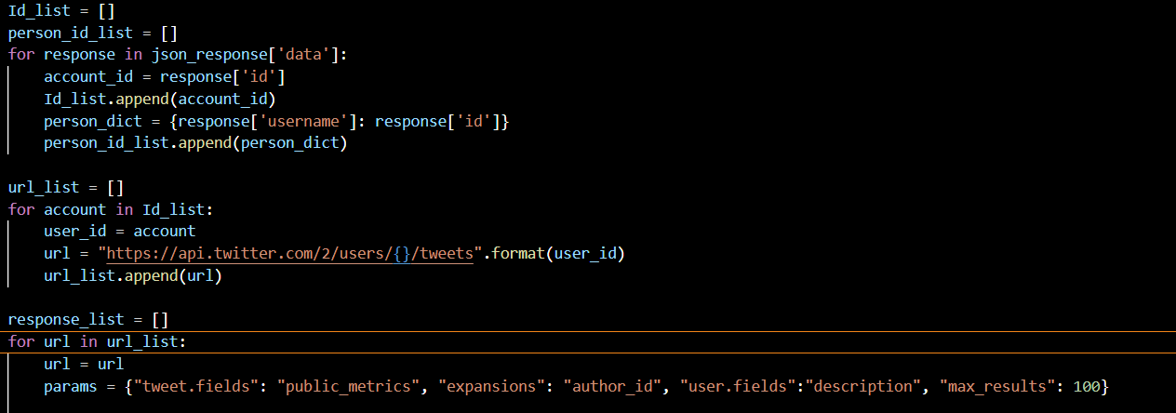
API Request Function

Slide 5
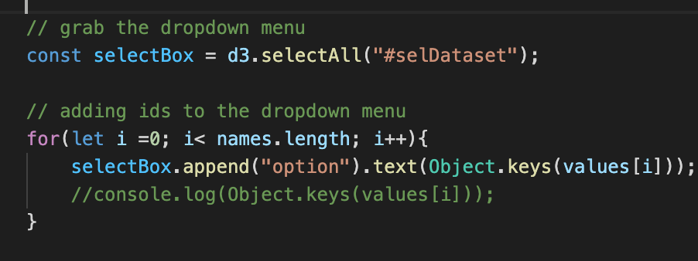
Update Dropdown Menu

Slide 6
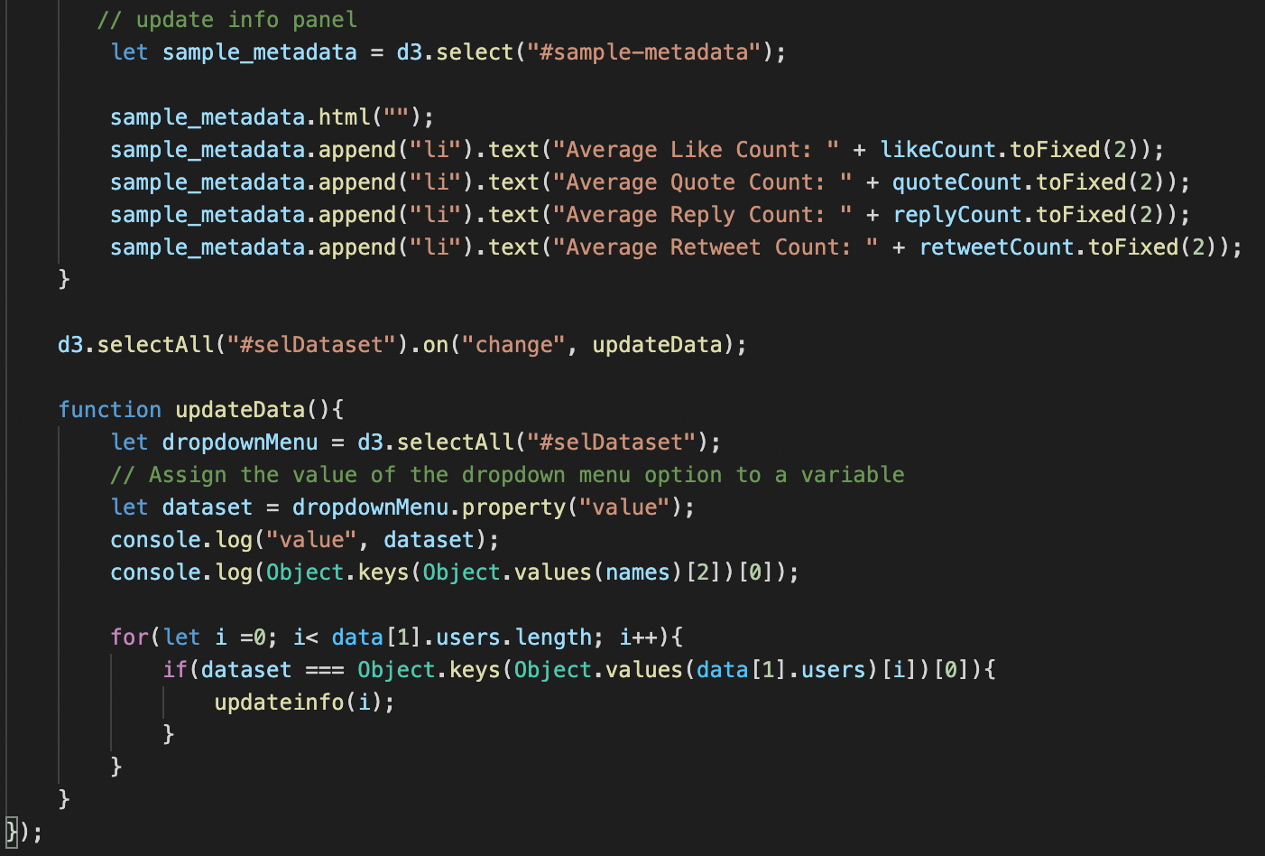
Update Panel Board

Slide 7
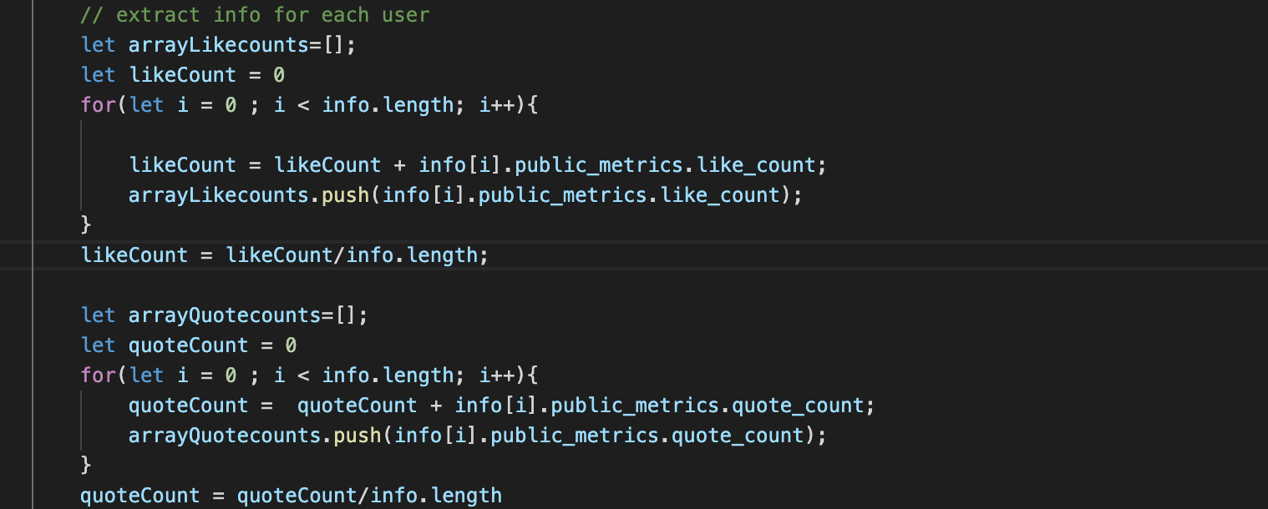
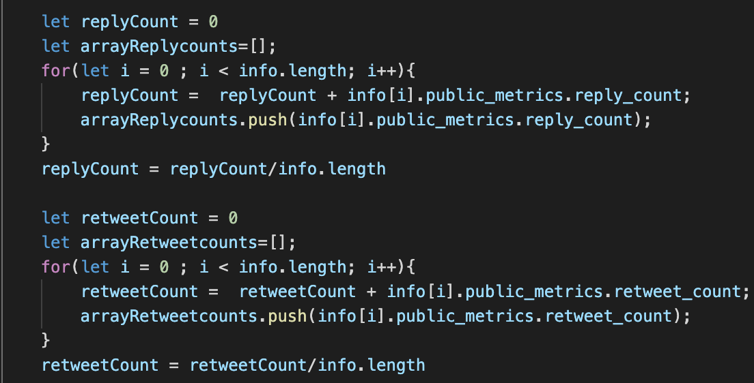
Collection data for dynamically updating chart

Slide 8
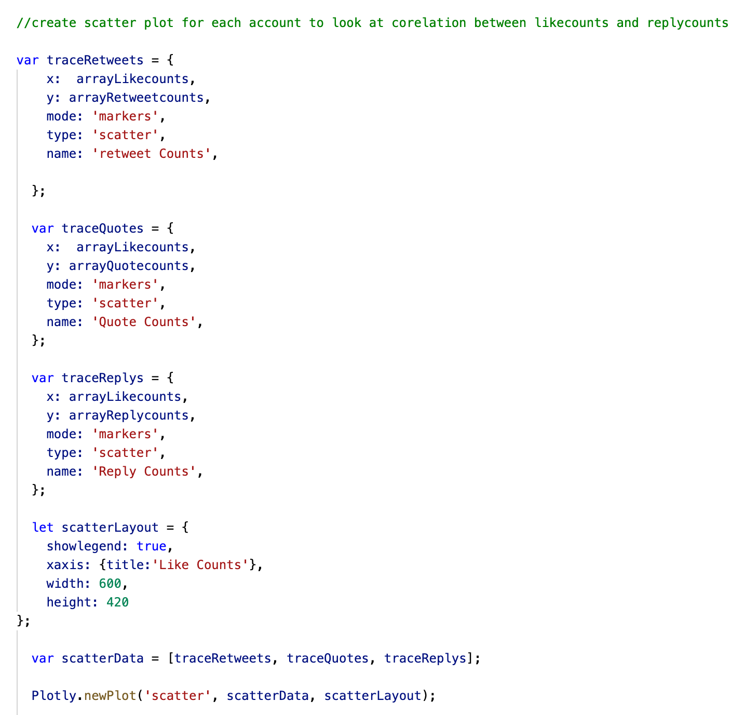
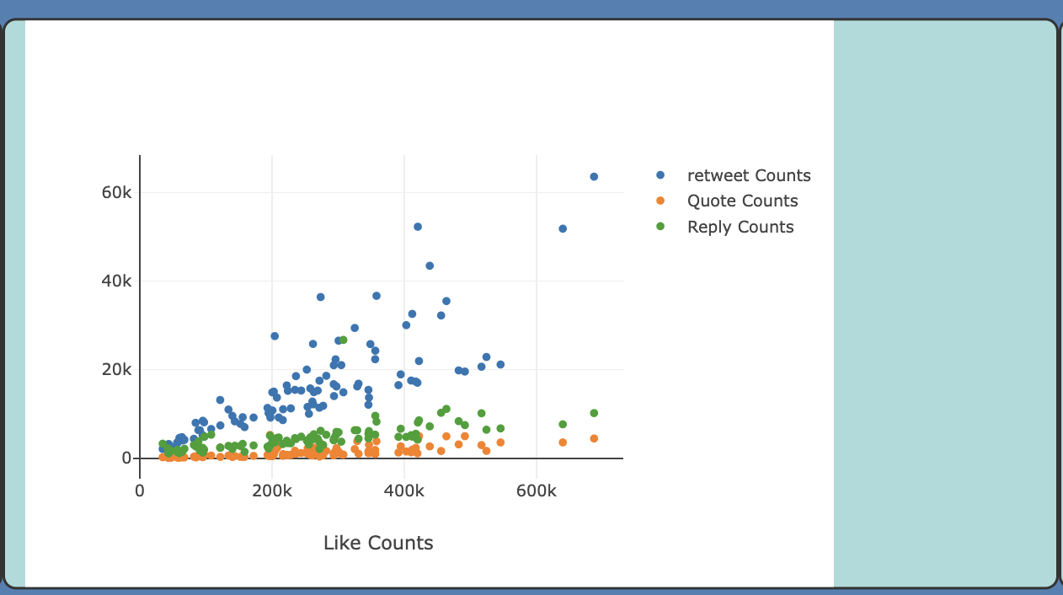
Scatter plot

Slide 9
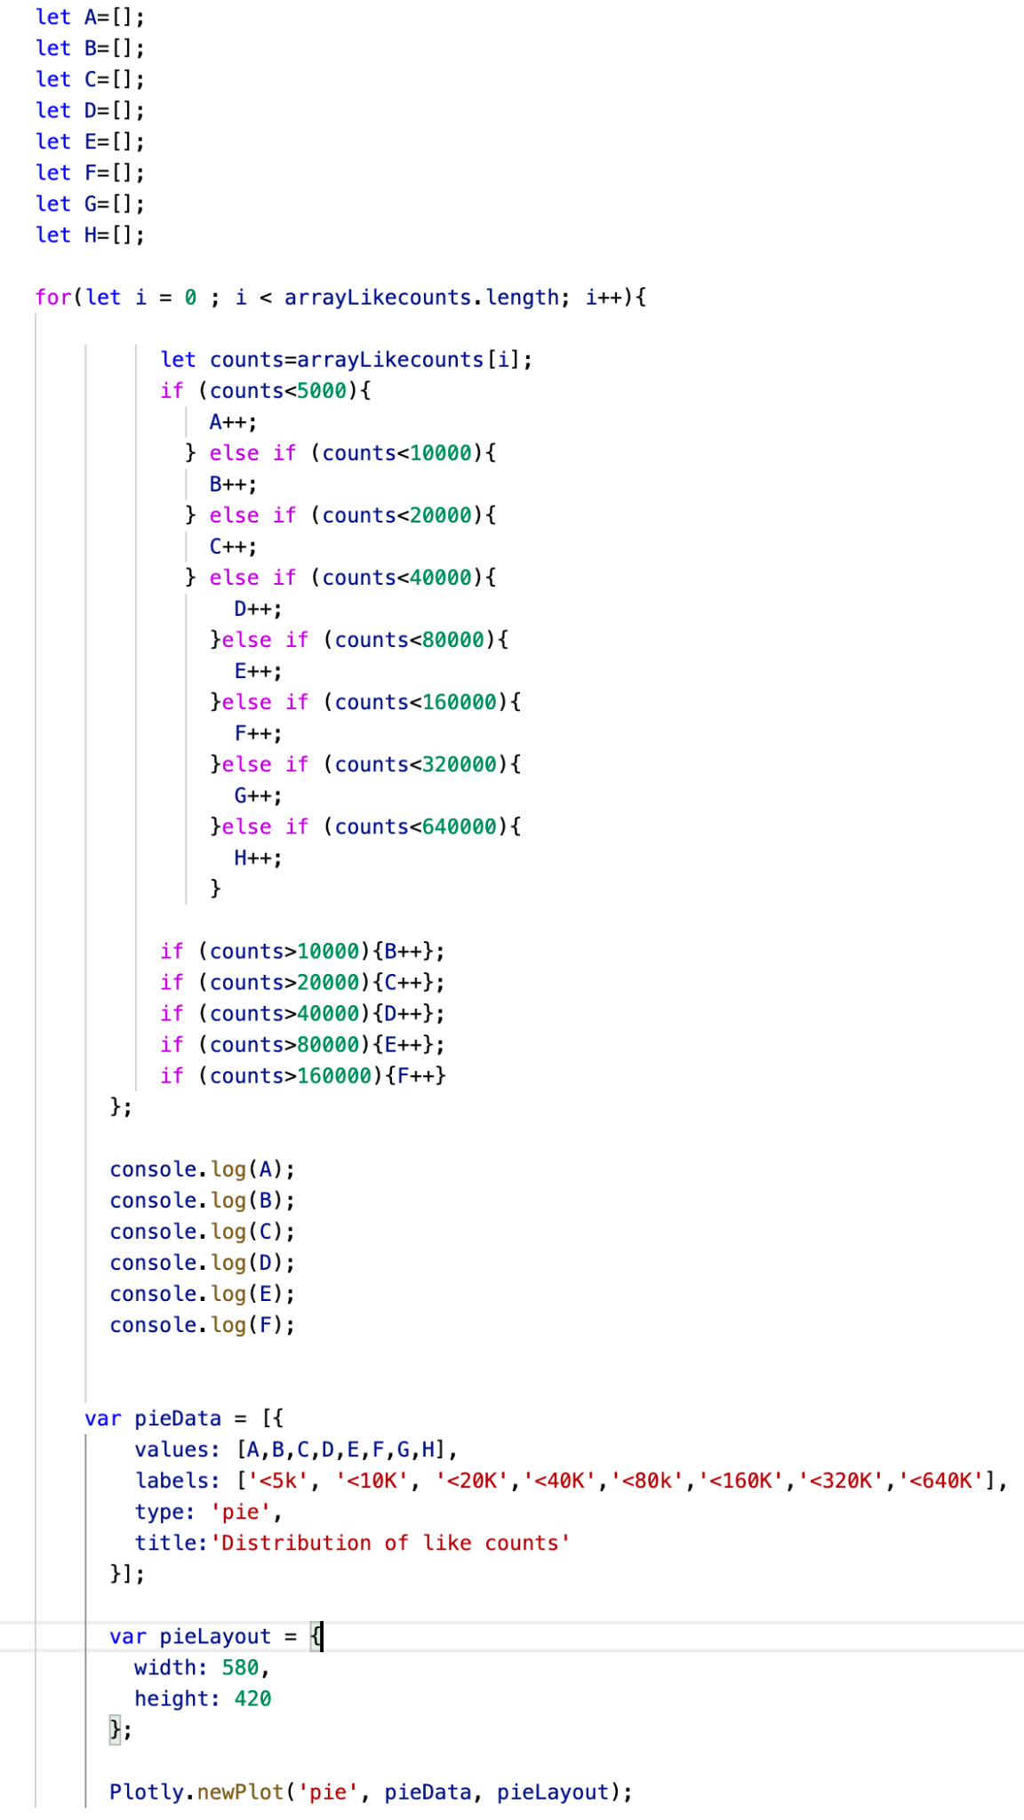
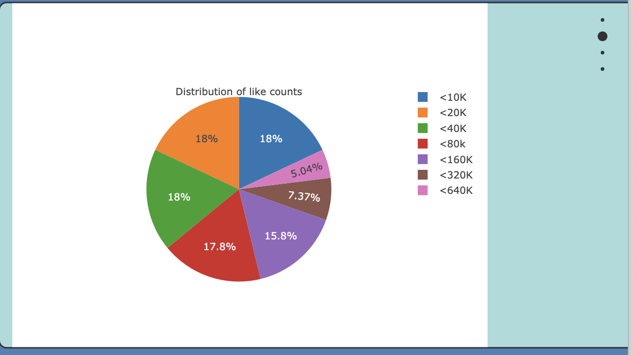
Pie chart for likecounts distribution

Slide 10
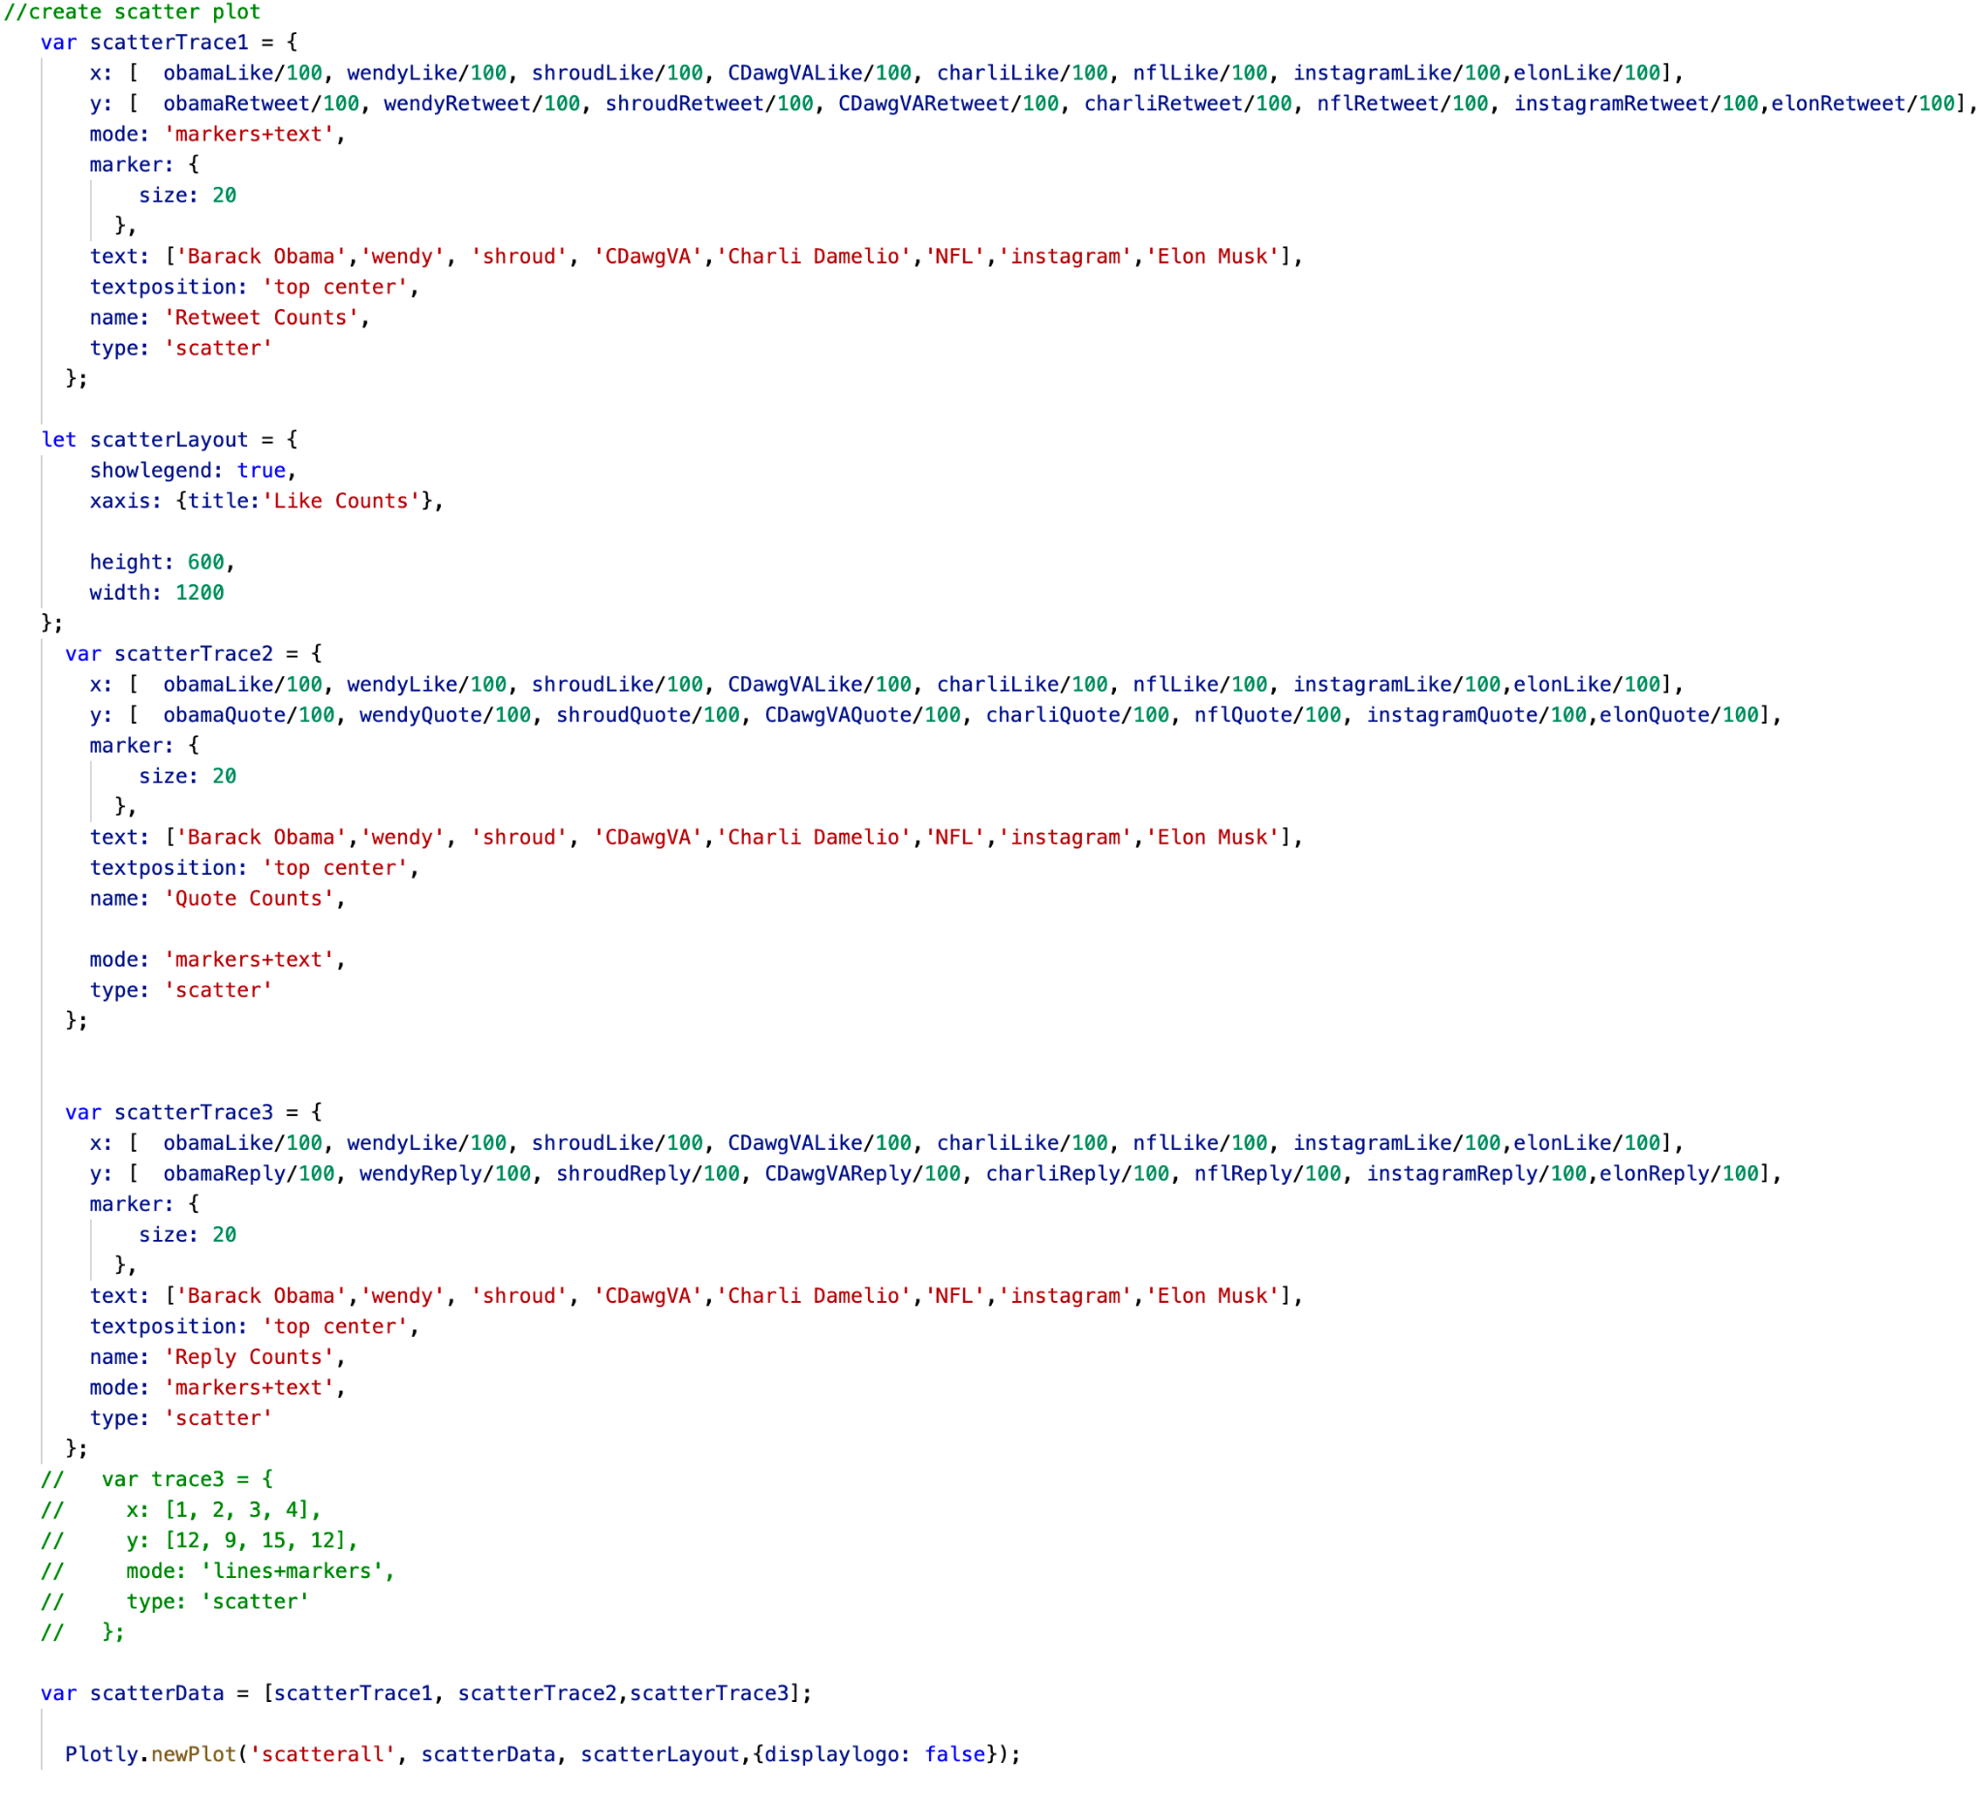
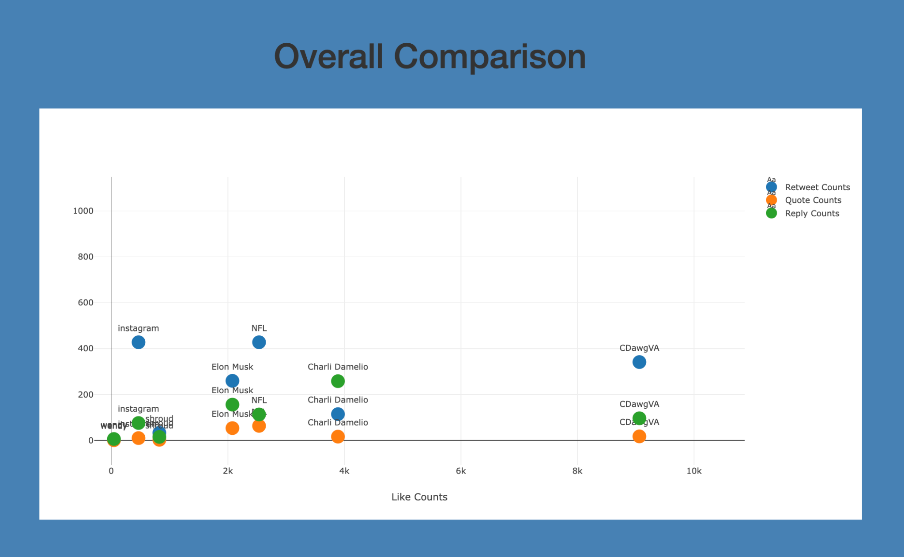
Comparison in scatter chart

Slide 11
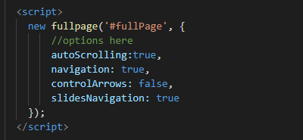
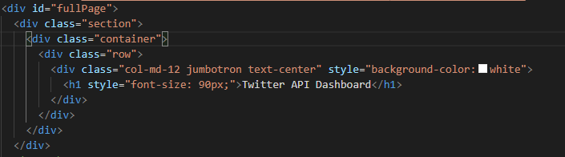
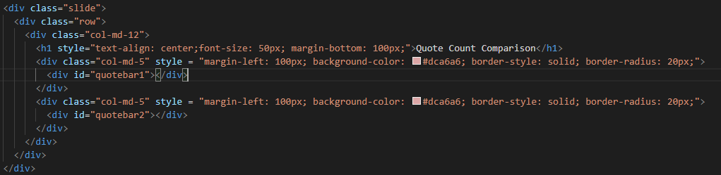
Fullpage.js and the HTML

Slide 12
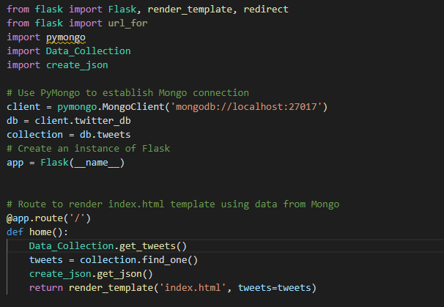
Flask and Mongo

Slide 13
Demo

